Slide 1
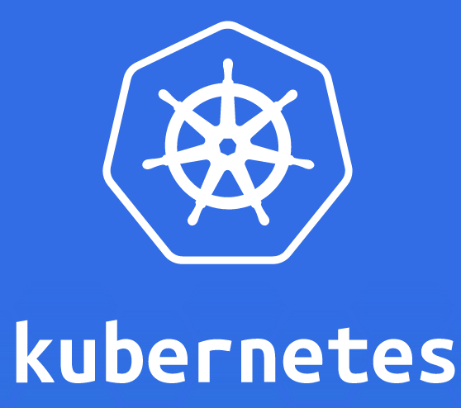
A Demo of basics
by
Kishore Potla

Slide 2
Agenda
Introduction – What is Kubernetes
Kubernetes Cluster
Kubernetes Components
Kubernetes Cluster Configuration
Kubectl basic commands
Application Deployment
Kubernetes pods
Executing on Containers
Kubernetes Services.

Slide 3
What is Kubernetes
A highly available cluster of computers that are connected to work as a single unit
Service for Container Cluster Management
Kubernetes is an open-source platform by Google
K8s is an abbreviation derived by replacing the 8 letters with “8” from Kubernetes
Used to manage Docker containers as a default implementation

Slide 4
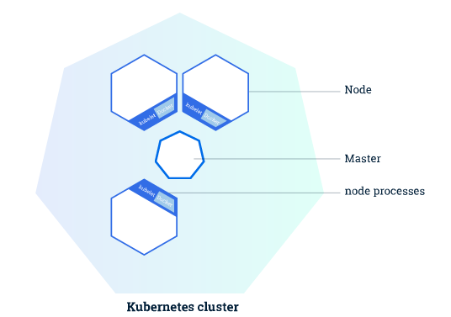
Kubernetes Cluster
Kubernetes cluster consists of 2 types of resources
Master
Master is responsible for managing the cluster
Coordinates cluster activities like scheduling, maintaining,
scaling of applications and rolling out new updates
2. Nodes
Node is a VM or a physical computer that serves as a worker
machine in Kubernetes cluster
Each node has a Kubelet, which is an agent for managing the node
and communicating with the Kubernetes master
The nodes communicate with the master using the Kubernetes API, which the master exposes
Master maintains the state of the Kubernetes in the etcd backend.

Slide 5
Kubernetes Components
Master Components
Master components provide the cluster’s control plane
Kube-apiserver: A component on the master that exposes the Kubernetes API. It is the front end for the Kubernetes control plane
Etcd: Consistent and highly-available key value store used as Kubernetes’ backing store for all cluster data
Kube-scheduler: Component on the master that watches newly created pods that have no node assigned, and selects a node for them to run on
Kube-controller-manager: Component on the master that runs controllers
Node Controller: Responsible for noticing and responding when nodes go down.
Replication Controller: Responsible for maintaining the correct number of pods
Endpoints Controller: Populates the Endpoints object (that is, joins Services & Pods).
Service Account & Token Controllers: Create default accounts and API access tokens for new namespaces
Clould-controller-manager: It runs controllers that interact with the underlying cloud providers.

Slide 6
Kubernetes Components (Conti..)
Node Components
Node components run on every node, maintaining running pods and providing the Kubernetes runtime environment.
kubelet: An agent that runs on each node in the cluster. It makes sure that containers are running in a pod.
Kube-proxy: enables the Kubernetes service abstraction by maintaining network rules on the host and performing connection forwarding
Container Runtime: The container runtime is the software that is responsible for running containers. Kubernetes supports several runtimes: Docker, rkt

Slide 7
Kubernetes Cluster Configuration
Three different ways to configure a Kubernetes Cluster.
Minikube: Minikube is a tool that makes it easy to run Kubernetes locally. Minikube runs a single-node Kubernetes cluster inside a VM on your laptop for users looking to try out Kubernetes or develop with it day-to-day. Installation Reference: https://kubernetes.io/docs/getting-started-guides/minikube/
Interactive tutorial using Minikube: https://kubernetes.io/docs/tutorials/kubernetes-basics/
2. Kubeadm: kubeadm is a toolkit that helps you bootstrap a best-practice Kubernetes cluster in an easy, reasonably secure and
extensible way.
Installing Kubeadm: https://kubernetes.io/docs/setup/independent/install-kubeadm/
Creating cluster using Kubeadm: https://kubernetes.io/docs/setup/independent/create-cluster-kubeadm/
Creating custom cluster: In case of specific IaaS, networking, configuration management, or operating system
requirements then this will provide an outline of the steps you need to take. Note that it requires considerably more effort than using
one of the pre-defined guides.
Reference: https://kubernetes.io/docs/getting-started-guides/scratch/

Slide 8
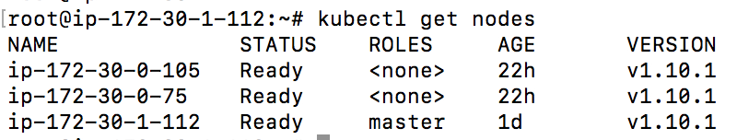
Kubectl – basic commands
To interact with Kubernetes we’ll use the command line interface, kubectl.
version: To check if kubectl is installed you can run the kubectl version command. we can see both the version of the client and as well as the server. The client version is the kubectl version; the server version is the Kubernetes version installed on the master
Cluster-info: To get cluster details.
Get nodes: Shows all nodes that can be used to host our applications

Slide 9
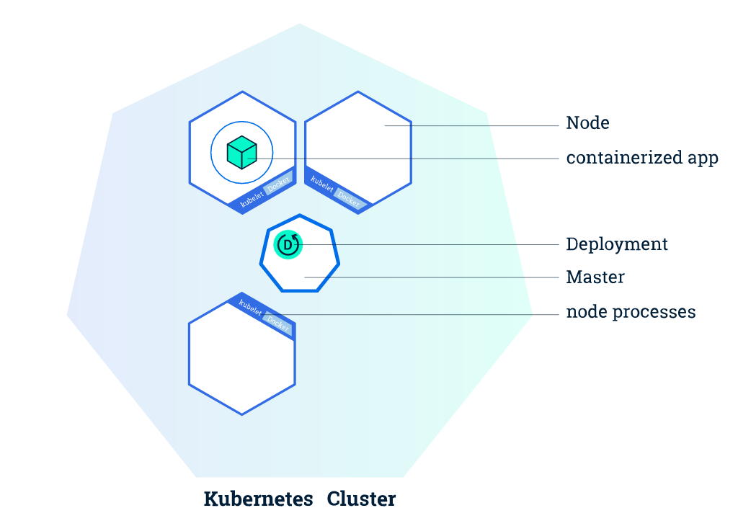
Application Deployment
Kubernetes Deployments
Create a Kubernetes Deployment configuration which instructs Kubernetes how to create and update instances of your application
Kubernetes master schedules mentioned application instances onto individual Nodes in the cluster
If any instance goes down or is deleted, the Deployment controller replaces it. This provides a self-healing mechanism to address machine failure or maintenance.
Deploying first app on Kubernetes
In deployment configuration file you need to mention:
Container image for application
Number of replicas
Container information
Labels and Selectors
Controller

Slide 10
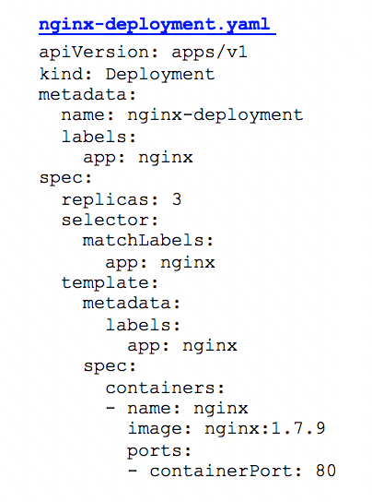
Application Deployment (Conti…)
Kubernetes Deployment Configuration file:
In this example:
A Deployment named nginx-deployment is created, indicated by the metadata: name field.
The Deployment creates 3 replicated Pods, indicated by the replicas field.
The selector field defines how the Deployment finds which Pods to manage. In this case, we simply select on one label defined in the Pod template (app: nginx).
The Pod template’s specification, or template: spec field, indicates that the Pods run one container, nginx, which runs the nginx Docker Hub image at version 1.7.9.
The template field contains the following instructions:
→The Pods are labeled app: nginx
→ Create one container and name it nginx.
→ Run the nginx image at version 1.7.9.
→ Open port 80 so that the container can send and accept traffic.

Slide 11
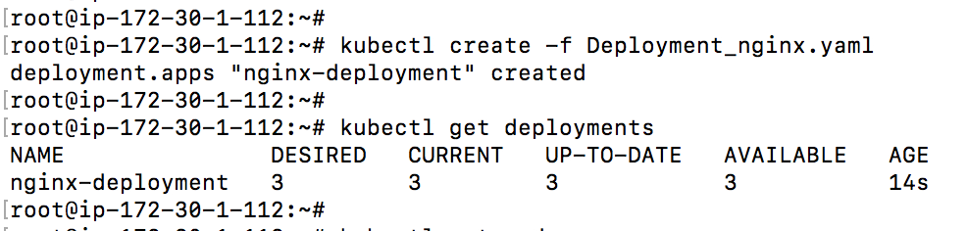
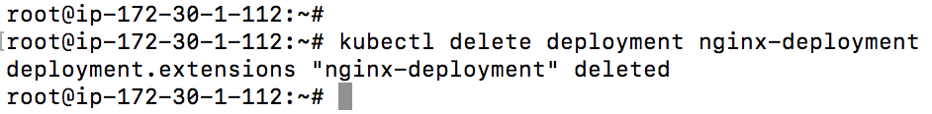
Application Deployment (Conti…)
Kubectl Deployment commands:
Create Deployment: create command creates a new deployment. You need to provide the deployment configuration filename.
Get Deployments: “get deployments” command provides the details about the deployments
Delete Deployment: Deletes the deployment by name.

Slide 12

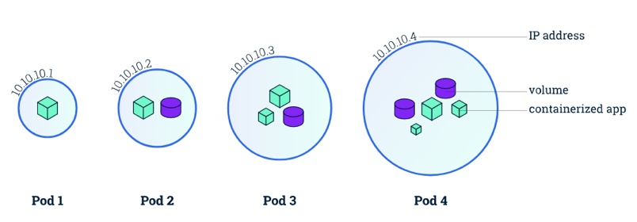

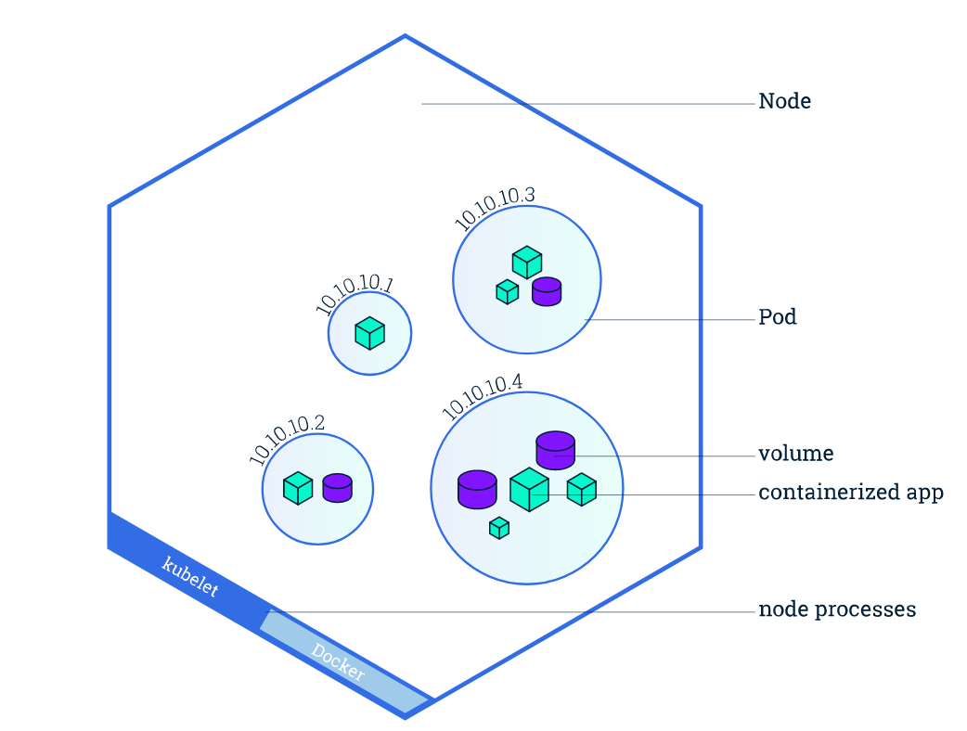
Kubernetes Pods
Pods:
Deployment creates pod to host your application instance.
A Pod is a Kubernetes abstraction that represents a group of one or more application containers and some shared resources for those containers.
Those shared resources include:
- Shared storage, as Volumes
- Networking, as a unique cluster IP address
- Information about how to run each container,
such as the container image version or specific ports to use
Every Kubernetes Node runs at least:
Kubelet - A process responsible for communication between the
Kubernetes Master and the Node; it manages the Pods and the containers
running on a machine.
A container runtime (like Docker, rkt) responsible for pulling the
container image from a registry, unpacking the container, and running the
application.

Slide 13

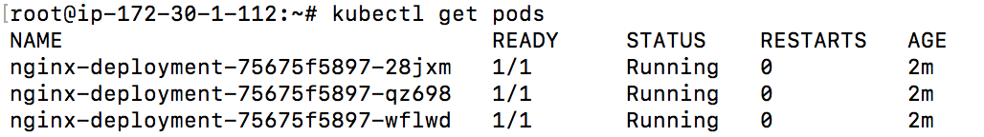


Kubernetes Pods (Conti…)
Pods commands:
Command used to look for the existing pods.
Command used to to view
what containers are inside that Pod
what images are used to build those containers.
Also the details about the Pod’s container: IP address, the ports used and a list of events related to the lifecycle of the Pod.
To view the container logs
Anything that the application would normally send to STDOUT becomes logs for the container within the Pod. We can retrieve these logs using the kubectl logs command

Slide 14
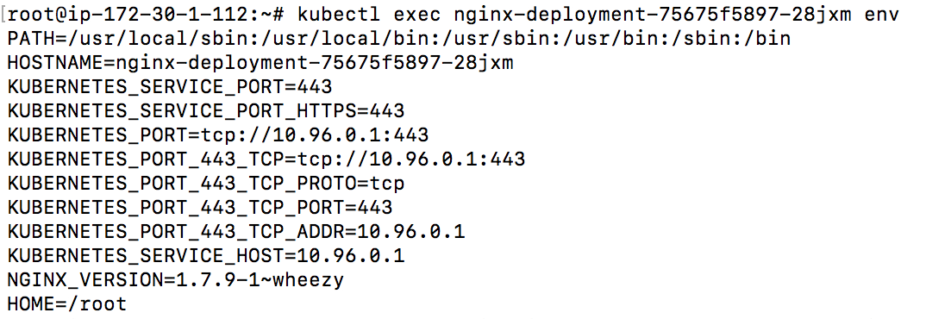
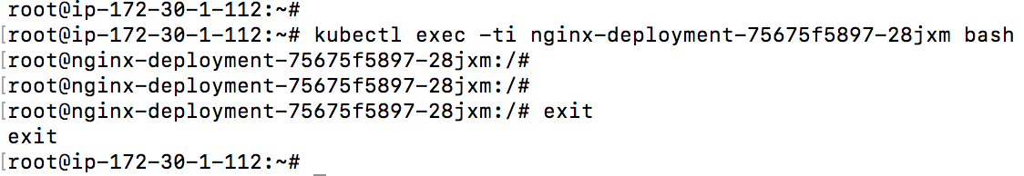
Executing Commands on Container
Kubectl exec: We can execute commands directly on the container once the Pod is up and running. For this, we use the exec command and use the name of the Pod as a parameter
List the environment variables:
Start a bash session in the Pod’s container:
Exit from the container:

Slide 15
Kubernetes Services
Service in Kubernetes:
A Service in Kubernetes is an abstraction which defines a logical set of Pods and a policy by which to access them
Services enable a loose coupling between dependent Pods
A Service is defined using YAML or JSON
The set of Pods targeted by a Service is usually determined by a LabelSelector
Although each Pod has a unique IP address, those IPs are not exposed outside the cluster without a Service
Services can be exposed in different ways by specifying a type in the ServiceSpec:
ClusterIP (default) - Exposes the Service on an internal IP in the cluster. This type makes the Service only reachable from within the cluster.
NodePort - Exposes the Service on the same port of each selected Node in the cluster using NAT. Makes a Service accessible from outside the cluster using <NodeIP>:<NodePort>. Superset of ClusterIP.
LoadBalancer - Creates an external load balancer in the current cloud (if supported) and assigns a fixed, external IP to the Service. Superset of NodePort.
ExternalName - Exposes the Service using an arbitrary name (specified by externalName in the spec) by returning a CNAME record with the name. No proxy is used. This type requires v1.7 or higher of kube-dns.

Slide 16
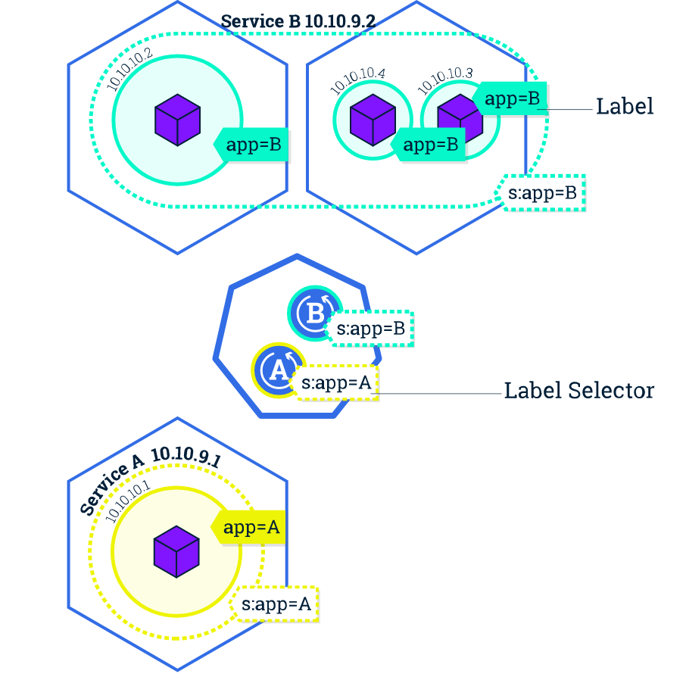
Kubernetes Services (Conti…)

Slide 17
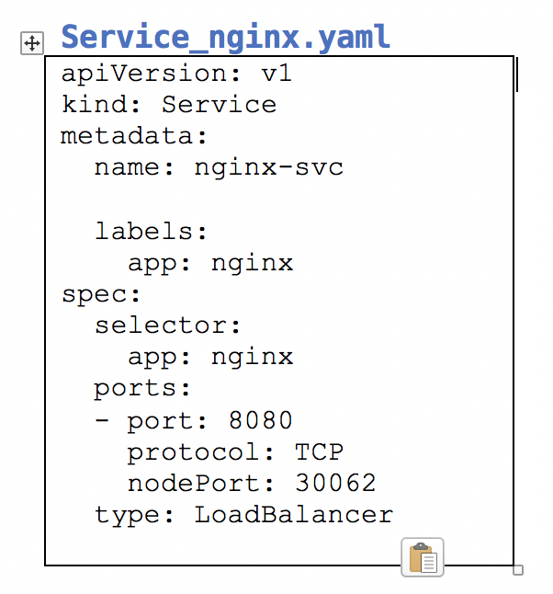
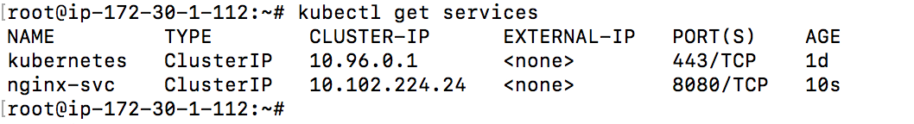
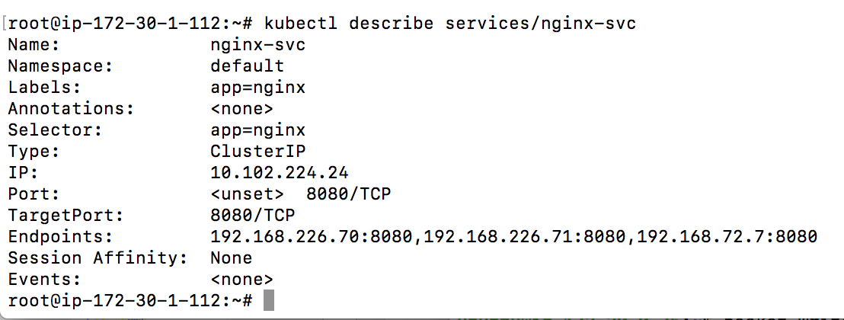
Kubernetes Services (Conti…)
Service example:
Kubectl expose command: To create and expose service.
kubectl get services: To list available services.
Kubectl describe service/<service name>: To find out what port was opened externally

Slide 18
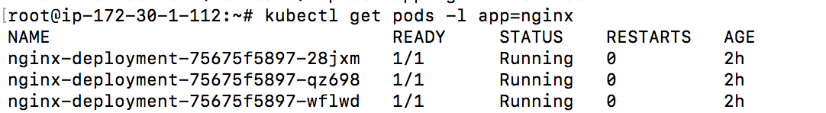
Kubernetes Services (Conti…)
Using labels:
Query list of pods with label:
Query list of services with label:

Slide 19
Thank you Question?

